Slide 1

Research Methodology
Research Proposal Fundamentals
Dr Arti Arya
Department of Computer Science and Engineering

Slide 2

RESEARCH METHODOLOGY
Research Proposal Fundamentals
Dr Arti Arya
Department of Computer Science and Engineering

Slide 3
Research Methodology
Research Proposal Fundamentals
Grant Proposal
A grant proposal is a very clear, direct document written to a particular organization or funding agency with the purpose of persuading the reviewers to provide you with support because:
you have an important and fully considered plan to advance a valuable cause
you are responsible and capable of realizing that plan.
As you begin planning and drafting your grant proposal, ask yourself:
Who is your audience?
What are the particular expectations for this grant?
How do you establish your credibility?
How can you clearly and logically present your plan?

Slide 4
Research Methodology
Research Proposal Fundamentals
Common Elements of Grant Proposals
Grant proposals are often organized in distinct sections. These sections have different titles depending on the guidelines specified by the granting organization, but they frequently serve the same purposes. In what follows, we identify some of the main elements of grant proposals, consider the work that section needs to do, and provide tips for successfully composing these sections. However, remember, as you write your proposal, follow that grant’s guidelines and use the exact section headings provided by the call for proposals.

Slide 5
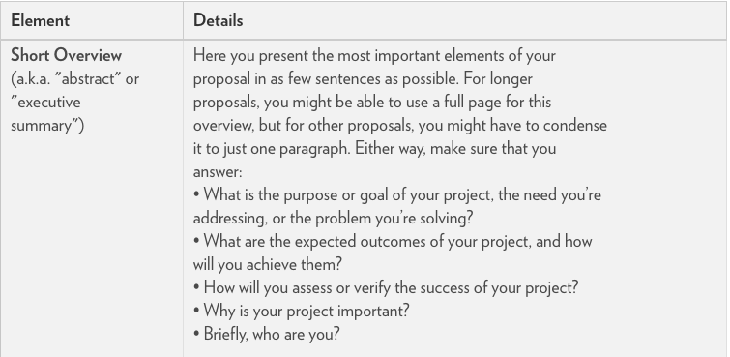
Research Methodology
Research Proposal Fundamentals

Slide 6
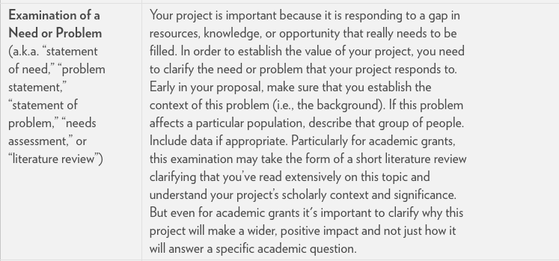
Research Methodology
Research Proposal Fundamentals

Slide 7
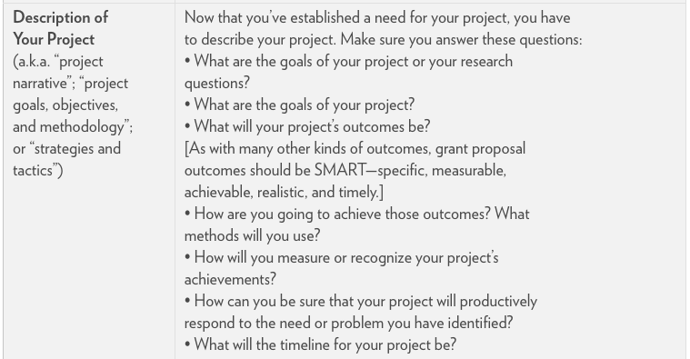
Research Methodology
Research Proposal Fundamentals

Slide 8
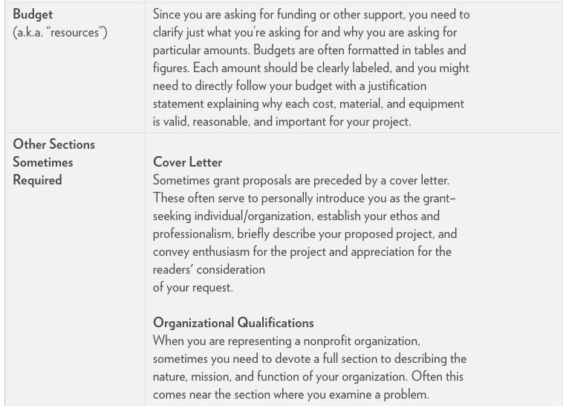
Research Methodology
Research Proposal Fundamentals

Slide 9
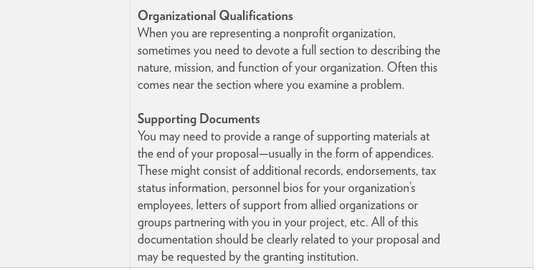
Research Methodology
Research Proposal Fundamentals

Slide 10
Research Methodology
Research Proposal Fundamentals
General Tips
Pay attention to the agency’s key interests.
Organize ideas through numbered lists.
Write carefully customized proposals.
Go after grants of all sizes.
Don’t give up! Keep on writing!

Slide 11
Research Methodology
Research Proposal Fundamentals
Scientific Misconduct
(1) Scientific misconduct, on the other hand, is violating ethical standards, giving false information, infringing intellectual property rights of others or compromising their research activity in another way, either intentionally or by gross negligence in a setting relevant to science and academia. The specific circumstances of each individual case shall be decisive.
(2) As examples of scientific misconduct can, in particular, be considered:
1. giving false information by
inventing data;
falsifying data or sources, for example by
holding back relevant sources, evidence, or texts,
manipulating sources, illustrations, and/or images,
selecting and dismissing unwanted results without disclosure;
including incorrect information or details in a letter of application or grant application (including false information on a publication medium or forthcoming publications pending printing);
applicants making false statements with regard to academic or scientific achievements when interviewed by a selection committee or an experts' panel;

Slide 12
Research Methodology
Research Proposal Fundamentals
2. infringement of intellectual property
with regard to a copyrighted piece of work of another individual or significant scientific findings, hypotheses, teachings, or research approaches of others notably through
the unauthorized use of material claiming authorship (plagiarism),
exploitation of unpublished research approaches or ideas, particularly as expert and/or reviewer (theft of ideas),
claiming scientific authorship or co-authorship without having made any scientific contribution,
falsification of content,
unauthorized publishing or unauthorized sharing with third parties while the piece of work, the findings, the hypothesis, teaching content, or the research approach has not been published or made public,
using another person's name as (co-)author without their permission;

Slide 13
Research Methodology
Research Proposal Fundamentals
3. compromising research activity of others by
sabotaging research activity, for example, by
damaging, destroying, or manipulating experiment installations, equipment or devices, documents, hardware, software, chemicals, or other items or matters that the other person needs to carry out an experiment,
maliciously altering or removing books, archive records, manuscripts, data records,
intentionally making scientifically relevant data storage media unusable;
eliminating primary data insofar as this violates legal requirements or provisions or established principles for scientific work in the respective discipline;
destroying research material without permission or disclosing it to third parties without permission.

Slide 14
Research Methodology
Research Proposal Fundamentals
Ethical Standards:
Association for computing machinery
https://www.acm.org/binaries/content/assets/membership/images2/fac-stu-poster-code.pdf
Link for the explanation of ACM code ethics
https://www.acm.org/code-of-ethics

Slide 15
Research Methodology
Research Proposal Fundamentals
IEEE Code of Ethics
We, the members of the IEEE, in recognition of the importance of our technologies in affecting the quality of life throughout the world, and in accepting a personal obligation to our profession, its members and the communities we serve, do hereby commit ourselves to the highest ethical and professional conduct and agree:
I. To uphold the highest standards of integrity, responsible behavior, and ethical conduct in professional activities.
1. to hold paramount the safety, health, and welfare of the public, to strive to comply with ethical design and sustainable development practices, to protect the privacy of others, and to disclose promptly factors that might endanger the public or the environment;
2. to avoid real or perceived conflicts of interest whenever possible, and to disclose them to affected parties when they do exist;
3. to avoid unlawful conduct in professional activities, and to reject bribery in all its forms;
4. to seek, accept, and offer honest criticism of technical work, to acknowledge and correct errors, to be honest and realistic in stating claims or estimates based on available data, and to credit properly the contributions of others;
5. to maintain and improve our technical competence and to undertake technological tasks for others only if qualified by training or experience, or after full disclosure of pertinent limitations;

Slide 16
Research Methodology
Research Proposal Fundamentals
II. To treat all persons fairly and with respect, to not engage in harassment or discrimination, and to avoid injuring others.
6. to treat all persons fairly and with respect, and to not engage in discrimination based on characteristics such as race, religion, gender, disability, age, national origin, sexual orientation, gender identity, or gender expression;
7. to not engage in harassment of any kind, including sexual harassment or bullying behavior;
8. to avoid injuring others, their property, reputation, or employment by false or malicious actions, rumors or any other verbal or physical abuses;
III. To strive to ensure this code is upheld by colleagues and co-workers.
19. to support colleagues and co-workers in following this code of ethics, to strive to ensure the code is upheld, and to not retaliate against individuals reporting a violation.

Slide 17
Research Methodology
Research Proposal Fundamentals
The Ten Commandments of Computer Ethics
Thou shalt not use a computer to harm other people.
Thou shalt not interfere with other people's computer work.
Thou shalt not snoop around in other people's computer files.
Thou shalt not use a computer to steal.
Thou shalt not use a computer to bear false witness.
Thou shalt not copy or use proprietary software for which you have not paid (without permission).
Thou shalt not use other people's computer resources without authorization or proper compensation.
Thou shalt not appropriate other people's intellectual output.
Thou shalt think about the social consequences of the program you are writing or the system you are designing.
Thou shalt always use a computer in ways that ensure consideration and respect for other humans.^{[8]}

Slide 18
Research Methodology
Research Proposal Fundamentals
Intellectual Property Rights(IPR)
What are intellectual property rights? Intellectual property (IP) is a term referring to a brand, invention, design or other kind of creation, which a person or business has legal rights over. Almost all businesses own some form of IP, which could be a business asset. Common types of IP include:
Copyright – this protects written or published works such as books, songs, films, web content and artistic works;
Patents – this protects commercial inventions, for example, a new business product or process; y Designs – this protects designs, such as drawings or computer models;
Trademarks – this protects signs, symbols, logos, words or sounds that distinguish your products and services from those of your competitors.

Slide 19
Research Methodology
Research Proposal Fundamentals
IP can be either registered or unregistered.
With unregistered IP, you automatically have legal rights over your creation. Unregistered forms of IP include copyright, unregistered design rights, common law trademarks and database rights, confidential information and trade secrets. With registered IP, you will have to apply to an authority, such as the Intellectual Property Office in the UK, to have your rights recognised. If you do not do this, others are free to exploit your creations.
Registered forms of IP include patents, registered trademarks and registered design rights. Copyright is also registerable.

Slide 20
Research Methodology
Research Proposal Fundamentals
Intellectual property rights – systems in India
Copyright
India is a signatory to the Berne Convention on copyright. However, it may be a good idea to register your copyright as doing so may help to prove ownership if there are criminal proceedings against infringers. In most cases though, registration is not necessary to maintain a copyright infringement claim in India. Registration is made, in person or via a representative, with the Copyright Office. Since 2016, copyright policy was moved to India’s Ministry of Commerce and Industry. All IPRs are now administered by the Department for Industrial Property and Promotion (DIPP).
Internet piracy of films, music, games and software is an issue in India, as is unauthorised copying of physical books.

Slide 21
Research Methodology
Research Proposal Fundamentals
Patents
India’s Patents Act of 1970, 2003 Patent Rules and the 2016 Patent Amendment Rules set out the law concerning patents. As in the UK, there is no provision for utility model patents.
The regulatory authority for patents is the Patent Registrar under the office of the Controller General of Patents, Designs and Trademarks, which is part of India’s Ministry of Commerce and Industry. Patents are valid for 20 years from the date of filing an application, subject to an annual renewal fee.
India’s patent law operates under the ‘first to file’ principle – that is, if two people apply for a patent on an identical invention, the first one to file the application will be awarded the patent.

Slide 22
Research Methodology
Research Proposal Fundamentals
Trademarks
India’s trade mark laws consist of the 1999 Trade Marks Act and the Trade Marks Rules of 2002 and 2017.
The regulatory authority for patents is the Controller General of Patents, Designs and Trademarks under the Department of Industrial Policy and Promotion. The police now have more robust powers in enforcing trade mark law, including the ability to search premises and seize goods suspected of being counterfeit without a warrant. But these powers are tempered by the requirement for the police to seek the Trade Mark Registrar’s opinion on the registration of the mark before taking action. This adds to the delay and may result in counterfeit goods being removed or sold.

Slide 23
Research Methodology
Research Proposal Fundamentals
Because of the widespread practice of ‘cybersquatting’ – it is advisable for rights owners to register their domain names in India as trade marks as soon as possible.
Registration takes up to two years. A trademark in India is valid for ten years and can be renewed thereafter indefinitely for further ten-year periods.

Slide 24
Research Methodology
Research Proposal Fundamentals
Mendeley
Mendeley is a free reference manager and academic social network that can help you to organise your research, collaborate with others online and discover the latest research:
Automatically generate bibliographies
Collaborate easily with other researchers online
Easily import papers from other research software
Find relevant papers based on what you are reading
Access your papers from anywhere online
Read papers on the go, with iOS and Android apps
Need to install Mendeley Desktop, Mendeley web Importer and Citation Plugin

Slide 25
Research Methodology
Research Proposal Fundamentals
Overleaf
Overleaf is an online collaborative writing and publishing tool that makes the whole process of writing, editing and publishing scientific documents much quicker and easier.
Overleaf provides the convenience of an easy-to-use LaTeX editor with real-time collaboration and the fully compiled output produced automatically in the background as you type.
Key features of Overleaf
All you need is a web browser
Always have the latest version
Effortless sharing
Automatic real-time preview
Real-time track changes and commenting
Quickly find latex errors
Not just for papers

Slide 26
THANK YOU
Dr Arti Arya
artiarya@pes.edu

